Slide 1

INVESTING
SAVING
EMERGENCY FUND

Slide 2

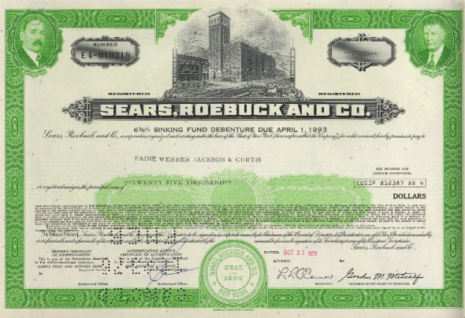


INVESTING
The act of allocating funds to an
asset with the expectation of
generating an income or profit.
We can invest money in:
securities, investment funds
purchase of a real estate,
works of art and collections, etc.

Slide 3




Investing criteria
Rate of return – what profit or utility will be gained from the investment
Payback period – time at which the spent expenditures will be returned
Risk rate – the probability of not gaining expected profit or utility
Note: Not every incurred amount is an investment:

Slide 4

SAVING
Putting certain amount of disposable income asaid.
We can save
without appreciation of money (at home) or
with appreciation of money by gaining interests (in a bank)

Slide 5
EMERGENCY FUND
WHAT is it? A bank account to save money on in order to cover big, unexpected expences – a health problem, a car repair, one´s unemployment, etc.
WHY do we need it? To keep us safe in a case of need, without the necessity of getting into debt (mostly if we already have a loan)
HOW MUCH should it be? The amount that covers one´s life costs for 3 - 6 months is recommended. In fact it depends on the saver´s financial situation.
HOW to build it? Set the monthly savings level. That creates a habbit of regular saving (for example permanent payment order for the transfer of money from one´s personal bank account)

Slide 6
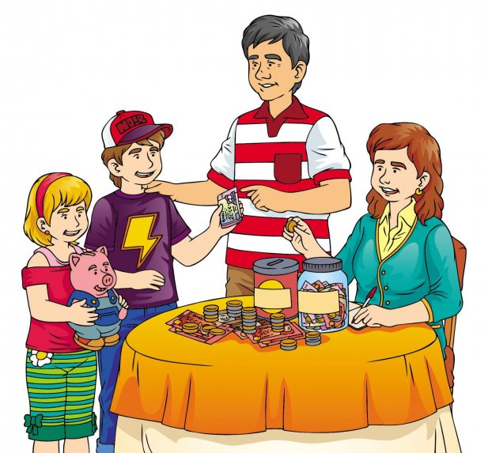
CASE STUDY
FAMILY MEMBERS: MONTHLY FAMILY INCOME:
Parent 1 Parent 1: xxx €
Parent 2 Parent 2: xxx €
X children aged xxx Other family members: xxx €
Other family members (grandparents) Child allowance: xxx €/child

Slide 7
TASK:
Suggest the monthly family budget – consider all incomes and expenditures
Think about the necessity of creating the emergency budget
Find out, whether your family can save some money
Suggest:
- what your family can invest money to,
- how much time they need to be able to buy suggested asset
- the amount to be saved monthly

Slide 8
THANK YOU

