Slide 1

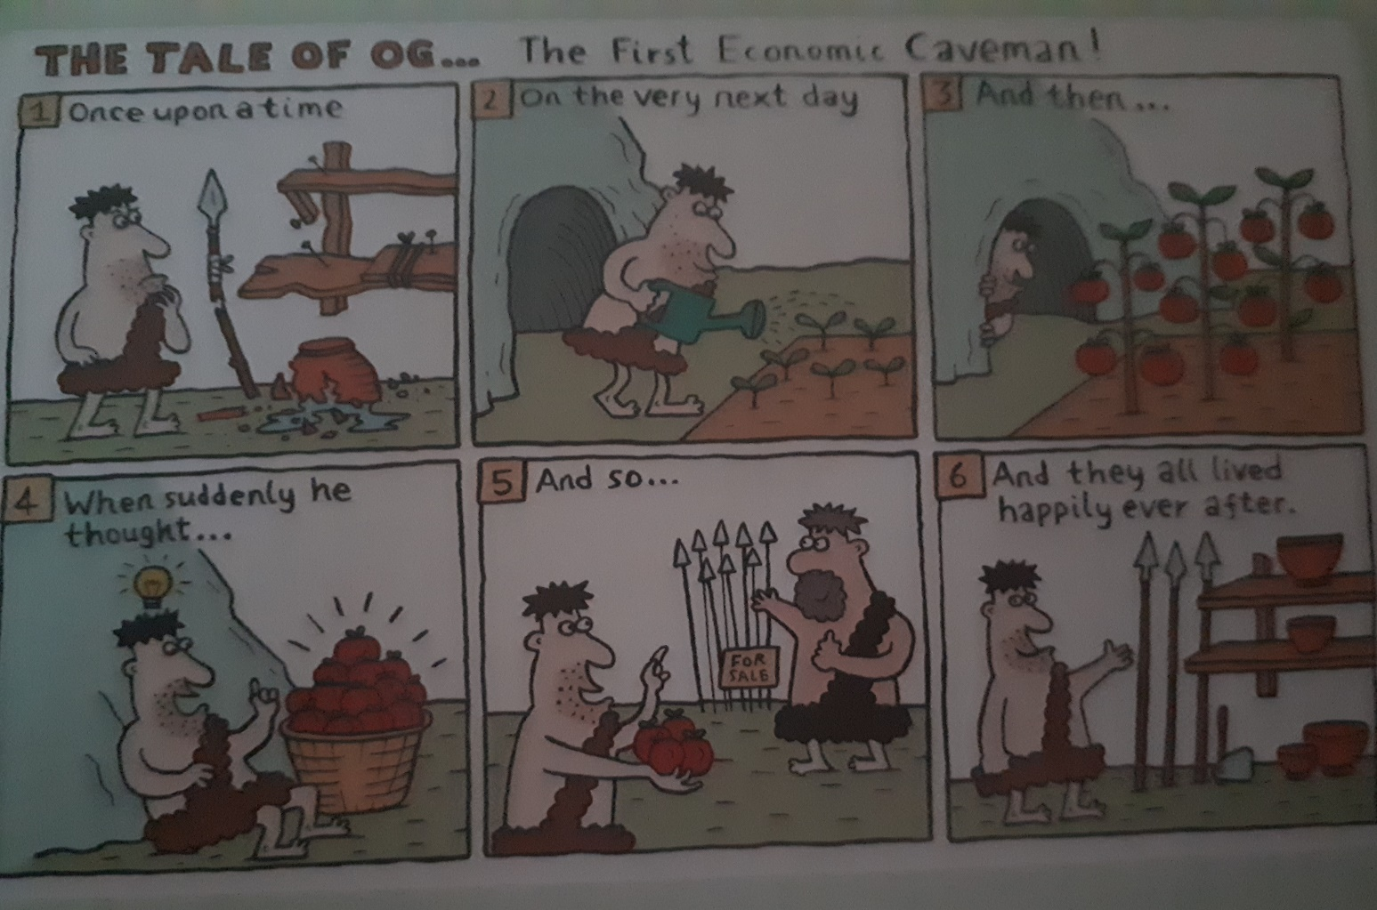
HISTORY OF MONEY
How it all began.... https://www.investopedia.com/articles/07/roots_of_money.asp

Slide 2
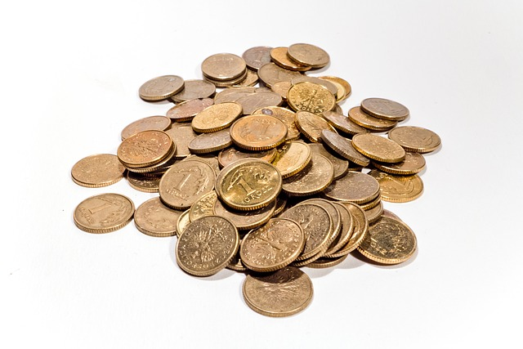
COINS

Slide 3
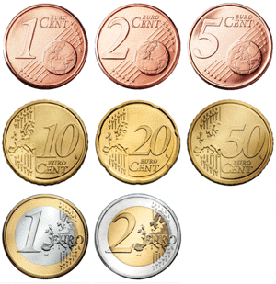
EURO COINS
Eight denominations
Common sides of coins are identical and show - images of the European Union or of Europe
- 12 stars of the European Union
- denomination
- currency name EURO
National sides – design was
chosen by each issuing country
individually

Slide 4
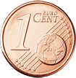
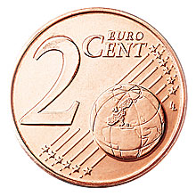
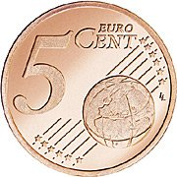
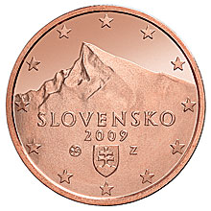
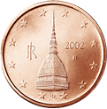
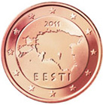
1, 2 and 5 cent
MATERIAL:
copper-covered steel
DESIGN:
Common side:
Europe in relation to
Africa and Asia on a
globe
National side:
individual in each
country
SLOVAKIA ITALY ESTONIA

Slide 5
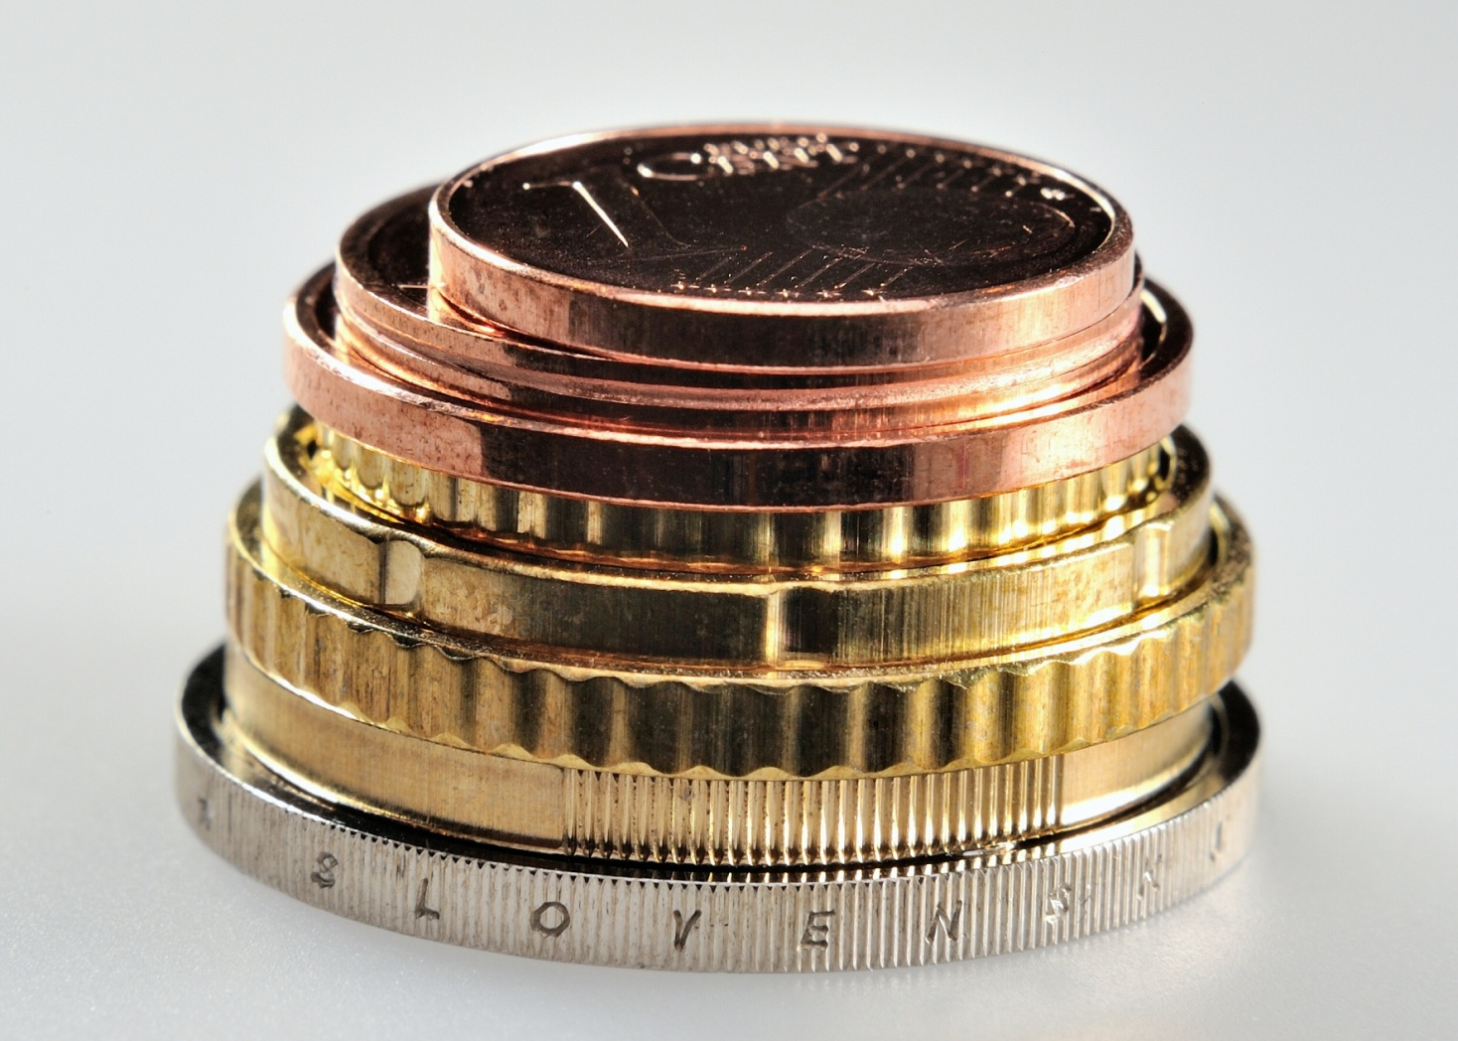
1, 2 and 5 cent
EDGE:
- 1 cent: smooth
- 2 cent: smooth with a groove
- 5 cent: smooth

Slide 6
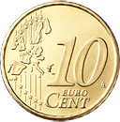
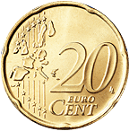
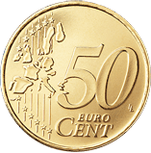
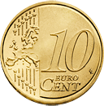
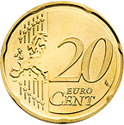
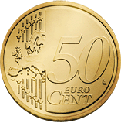
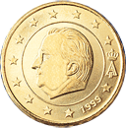
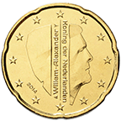
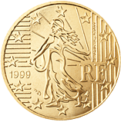
10, 20 and 50 cent
MATERIAL: Nordic gold
an alloy of copper, zinc,
aluminium and tin
DESIGN:
Common side: either the European Union before its enlargement on 1 May 2004 or, as of 1 January 2007, a geographical image of Europe
National side: individual in each country
BELGIUM NEDERLANDS FRANCE

Slide 7

10, 20 and 50 cent
EDGE:
- 10 cent: shaped edge with fine scallops
20 cent: plain with seven indents – shape called the Spanish flower
50 cent: shaped edge with fine scallops

Slide 8
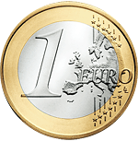
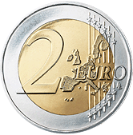
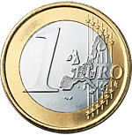
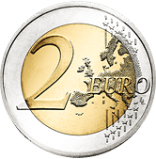
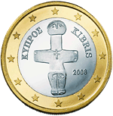
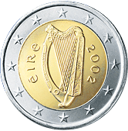
€1 and €2
MATERIAL:
€1: outer part: nickel brass
inner part: copper-nickel
€2: outer part: copper-nickel
inner part: nickel brass
DESIGN:
Common side: either the European Union before its enlargement on 1 May 2004 or, as of 1 January 2007, a geographical image of Europe
National side: individual in each country

Slide 9
€1 and €2
EDGE:
€1: interrupted milled
(a combination of smooth sixths and milled ones)
€2: fine milled with edge lettering
(each country has its own design)
MALTA
NEDERLANDS
AUSTRIA

Slide 10
Thank you

