Slide 1

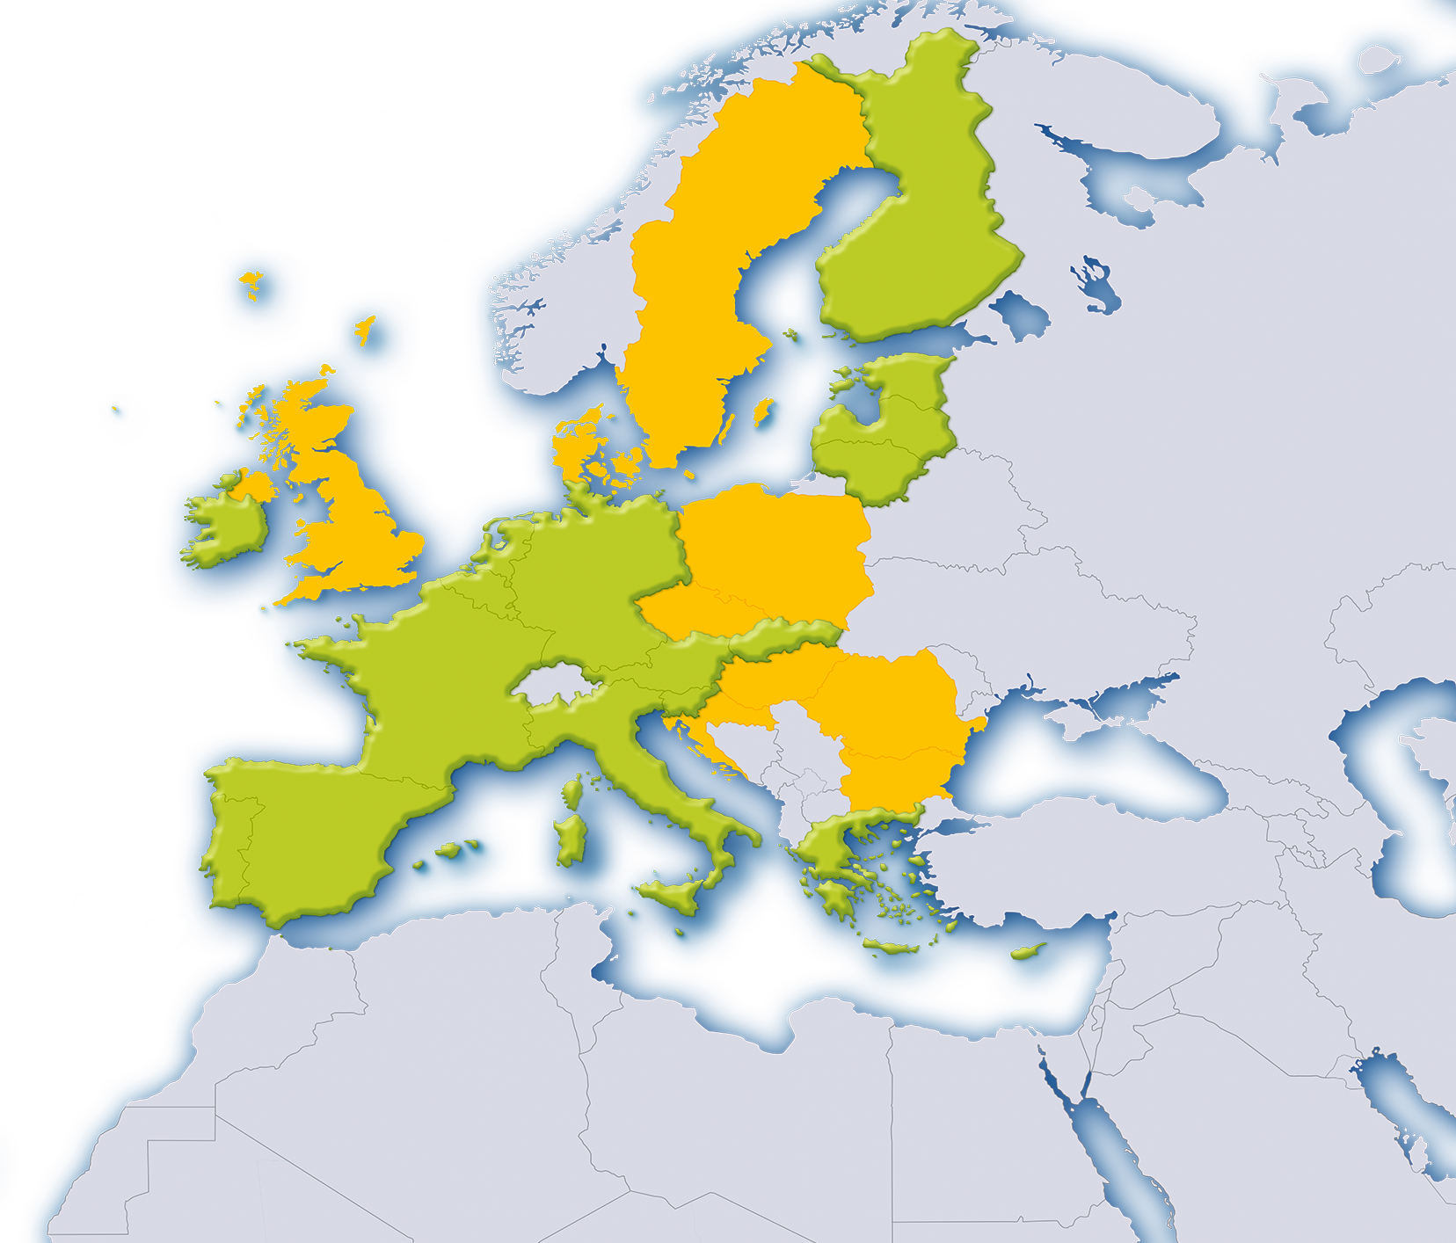


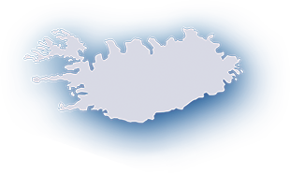




19 countries
338 million people
One currency – the euro!
Notes:
This presentation has been designed to help teachers explain the euro banknotes and coins to their pupils. Each slide is accompanied by further information in the notes pages. The presentation can be used in part or as a whole. We hope you find it useful.
More information on the euro banknotes and coins can be found at http://www.new-euro-banknotes.eu/ or https://www.ecb.europa.eu/euro/html/index.en.html

Slide 2

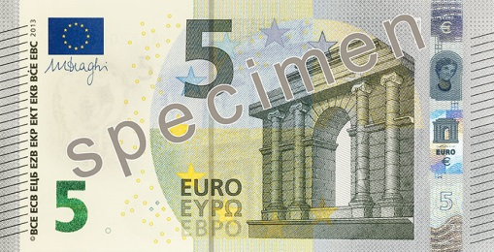
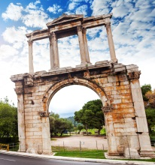
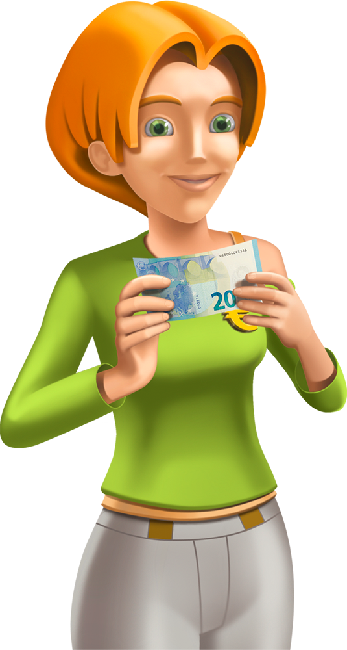
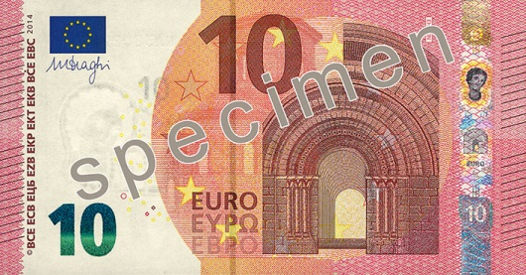
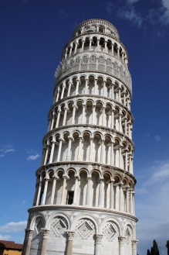
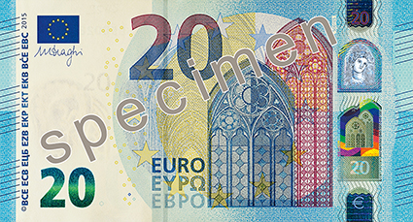
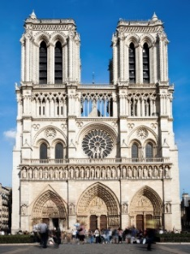
The Euro Banknotes
They each show a European architectural style
Ancient Greece and Rome
Romanesque
Gothic
2
Notes:
There are seven denominations of euro banknotes: €5, €10, €20, €50, €100, €200 and €500. The banknotes feature architectural styles from different periods in Europe's history in ascending chronological order. The €5 banknote shows the architectural style of ancient Greece and Rome, the €10 shows the Romanesque period (10th to 13th centuries) and the €20 shows the Gothic period (13th to 16th centuries), continuing up to the €500, which shows modern architecture. The architectural elements on the euro banknotes are stylised representations – none of them show exact representations of an existing building. The pictures here are indicative of the general architectural style shown on each banknote.
The first euro banknotes were designed by Robert Kalina of Austria’s central bank, the Oesterreichische Nationalbank. They entered into circulation in 2002. All the banknotes are currently being given extra protection with new security features, and their design is being refreshed. The new €5 was issued on 2 May 2013, the new €10 on 23 September 2014 and the new €20 will enter into circulation on 25 November 2015. The remaining denominations will be issued at dates to be determined and announced to the public and cash handlers at a later stage. Both the first and second series of banknotes are legal tender, and any change will be communicated well in advance.
Idea: You can replace the images here with images from your own country. You can also collect pictures of famous buildings and ask pupils to decide whether they are Classical, Romanesque or Gothic based on their style.
Some information on the buildings shown on this slide:
€5 banknote: Hadrian’s Arch in Athens, Greece
€10 banknote: The Leaning Tower of Pisa in Italy
€20 banknote: Notre-Dame Cathedral in Paris, France

Slide 3

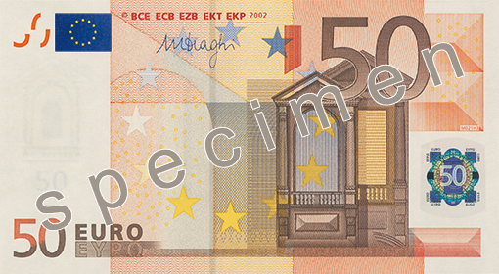
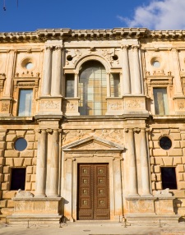
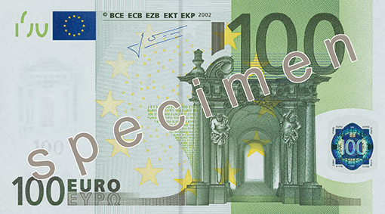
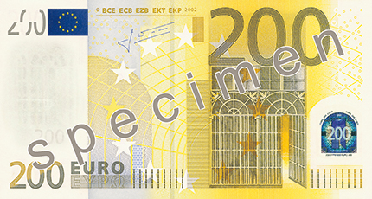
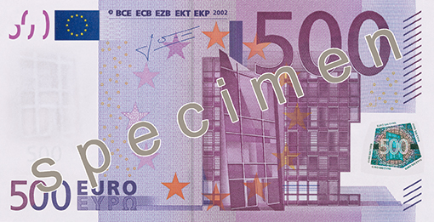
The Euro Banknotes
They show windows, doorways and bridges
Renaissance
Baroque
19th C – Iron and Glass
20th C
3
Notes:
Euro banknotes show windows or doorways on the front and bridges on the back.
Idea: As with the previous slide you can replace the image of the Renaissance building with an image from your own country. The image is of the Palace of Charles V in the Alhambra, Granada, Spain.

Slide 4
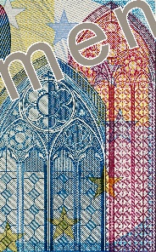
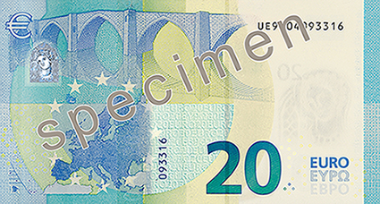
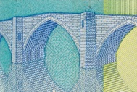
The Euro Banknotes
The windows and doorways symbolise the European spirit of openness and cooperation
The bridges symbolise communication between the people of Europe and between Europe and the rest of the world
4
Notes:
The windows and doorways on the front of the banknotes and the bridges on the back embody ideas.
The windows and doorways symbolise the European spirit of openness and cooperation.
The bridges symbolise communication between the people of Europe and between Europe and the rest of the world.

Slide 5


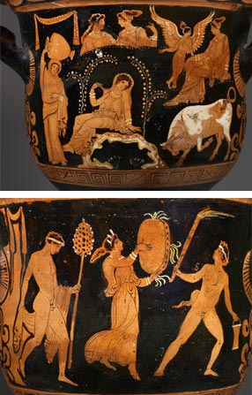
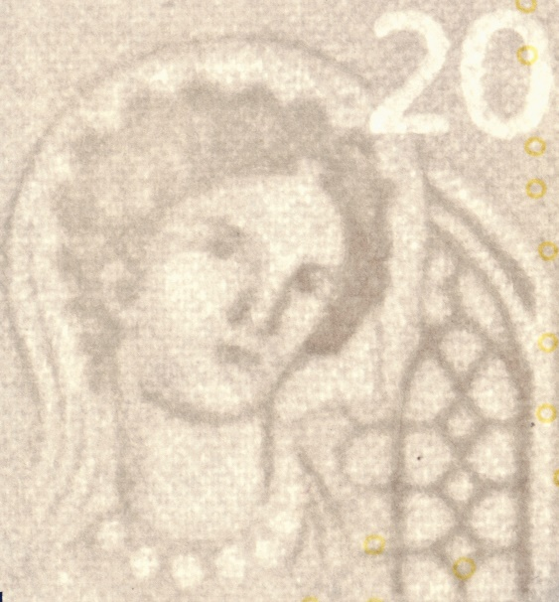
Europa
Hi!
My name is Europa.
I’m a princess from Greek mythology.
I gave my name to the continent
Greek vase with Europa, Louvre
Europa is in security features of the new banknotes.
5
Notes:
Europa, a figure from Greek mythology, is very important in the new series of banknotes. She appears in the watermark of all the new banknotes. On the new €20 banknote, in circulation as of 25 November 2015, she also appears in the top right hand corner in a new feature called the ‘portrait window’. Hold the banknote against the light to see!
Europa was chosen to feature in the new banknotes because she gave her name to the continent. The image of Europa used comes from an ancient Greek vase which is believed to have been painted around 360 BC in Taranto in the South of Italy. The vase is now in the Louvre Museum in Paris, France.
More information on Europa, including a video, can be found here: http://www.new-euro-banknotes.eu/Europa-Series/The-Myth-of-Europa

Slide 6





How do you know the
banknotes are genuine?
…and tilt!
It’s easy! Just feel…
look…
Feel
Look
Tilt
6
Notes:
It’s easy to check euro banknotes for authenticity. Just feel, look and tilt.

Slide 7
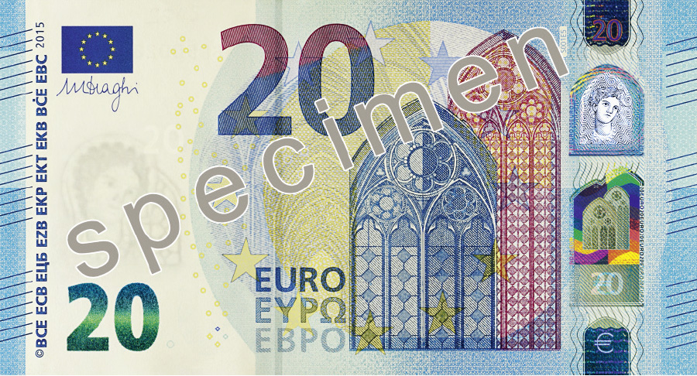
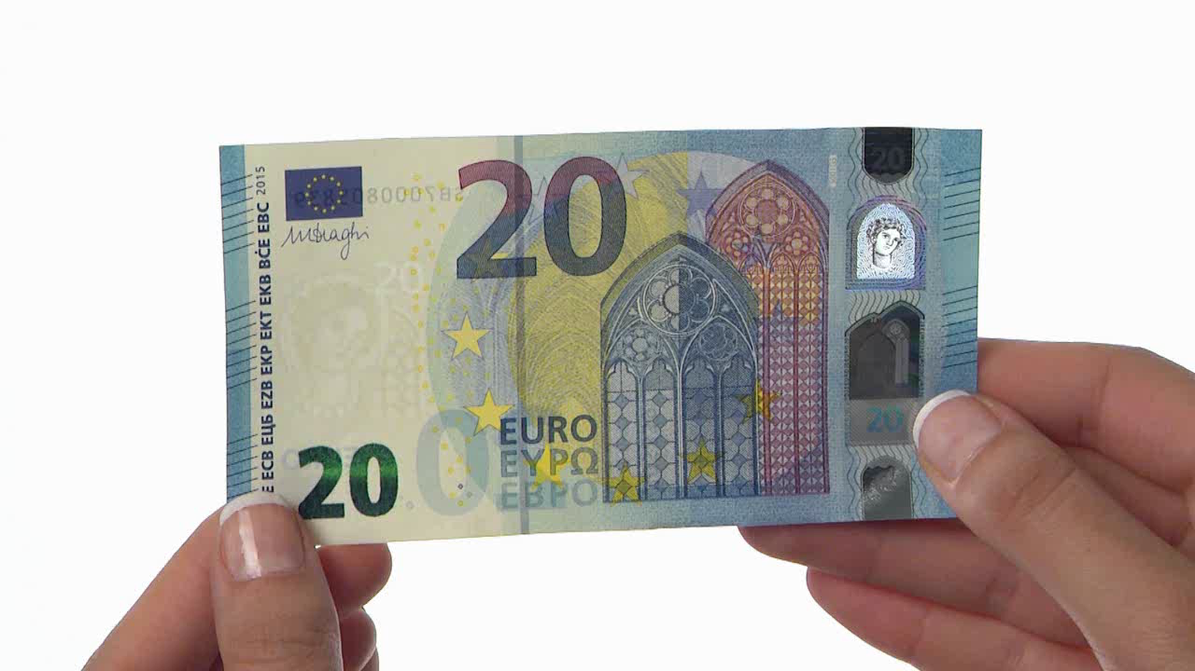
The Security Features
FEEL
The banknote feels crisp and firm.
There is raised print on the left and right edges.
7
Notes:
Click on the image of the banknote to see a film about how to check a €20 banknote for authenticity by feeling it.

Slide 8

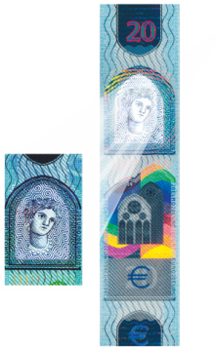


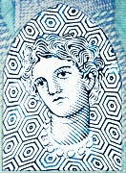
The Security Features
LOOK
Against the light the watermark shows a portrait of Europa and the value.
The portrait window reveals a portrait of Europa.
8
Notes:
8
Click on the image of the banknote to see a film about how to check a €20 banknote for authenticity by looking at it against the light.

Slide 9
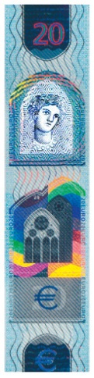


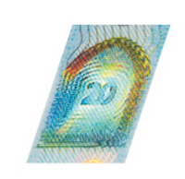
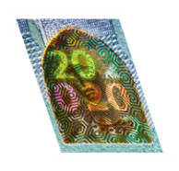
The Security Features
TILT
The hologram shows a portrait of Europa and the value. The portrait window shows rainbow-coloured lines when tilted. The emerald number displays an effect of the light that moves up and down.
9
Notes:
9
Click on the image of the banknote to see a film about how to check a €20 banknote for authenticity by tilting it.

Slide 10
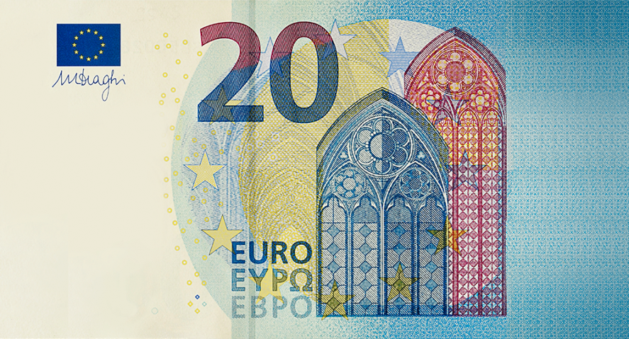
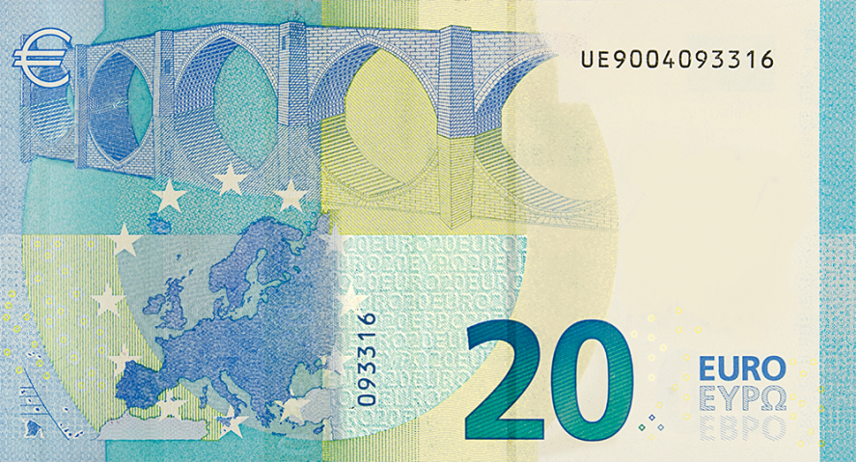




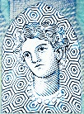
Put the security features
in the right place !
Emerald number
Watermark
Portrait window
Raised print
Hologram
10
Notes:
Here, you can construct a banknote by putting the security features in the right place.

Slide 11
EURO BANKNOTES SECURITY FEATURES video https://www.ecb.europa.eu/euro/banknotes/security/html/index.en.html

Slide 12
THANK YOU

